Slide 1
Interfaith marriage
A point of view

Slide 2
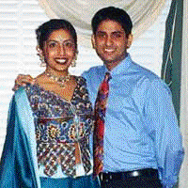
Religion is not just a collection of beliefs but a path of life
There should be no racial bias according to Sikh faith, hence, there is no racial bar against a marriage.
Regarding interfaith marriages, it should be well understood that such marriages will not be happy ones.
Religion is not just a collection of beliefs to be understood but a path of life one decides to follow.
Two spouses cannot simultaneously walk on two different paths, i.e. practice two faiths and still remain together as a couple.

Slide 3
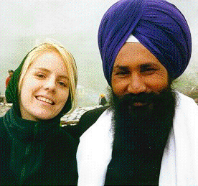
Otherwise, it is literally a marriage of convenience and not a marriage of minds and hearts.
It is not a true marriage where both partners cannot jointly practice their faith, the mission of their life.
Without practicing faith, we are no better than animals.
In case the two belong to different faiths, before they marry they must decide which faith they are going to follow.
It may be remembered that conversion for marriage does not mean a change of belief, but it is for a worldly advantage.
Such a wedding may soon create problems

Slide 4
Two case histories from interfaith marriages
a white lady married to a Sikh.

Slide 5
“My husband is a great human being.
While working for him as his secretary, I liked him.
We got married, even though my British parents did not agree with it.
Later, when they found my husband to be a nice and noble man and also financially well off, they reconciled with our marriage.
They now visit us regularly.
Before our relations became normal with them, we started facing other problems.

Slide 6
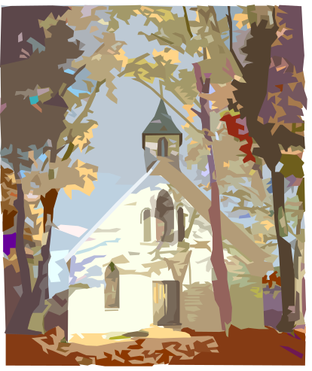
The problem of naming our children was easy to overcome.
We agreed to give them both Punjabi and Christian names.
The other problems, however, continue.
When we go to the church, none of us really benefit from it.
He does not believe in Christianity and he just sits there to be with me.
My mind remains constantly occupied with the idea that I am forcing one gentleman to sit there for nothing.
The same thing is experienced at the gurdwara where our roles are switched.
I do not understand Sikh sermons recited in Punjabi. He knows that I am there waiting for the function to be over.

Slide 7
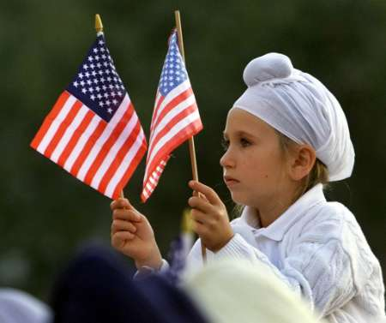
The third problem is regarding the faith of our children.
Should we raise them as Christians or as Sikhs?
It bothers me most and it also seems to have no solution.
He says, “I can raise them as Christians. However, as a true Christian, I feel it is sin to raise the children of a Sikh as Christians.
If we do not teach them any faith that also is a sin. I am really under great stress.”

Slide 8
Message
she summarized her experience in two sentences. “If you love a person of a different faith, be a sincere friend but do not marry that person.
By marriage, you will ruin the true meaning of life for both.”

Slide 9

A different experience of interfaith marriage
A European lady is married to a Sikh who cuts his hair.
She studied Sikh faith and had observed the Sikh culture before her marriage to him.
She not only accepted the Sikh philosophy and culture, but also practiced it sincerely.
She even taught Sikh heritage to the youth at the camps, of course, with some Christian element.
she gave a pleasant surprise to me by asking, “I want to become an Amritdhari Sikh. I wish my husband joins me. Please convince him to stop cutting his hair and also take Amrit.”

Slide 10
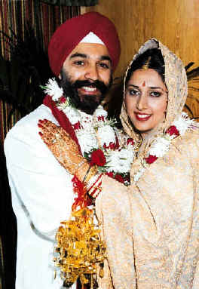
conclusion
The conclusion I draw from these two case histories is that one must marry within one’s faith.
In case of an interfaith marriage, they must, before their wedding, join one faith and sincerely live that faith to have peace and achieve the mission of human life.

